Slide 1


Data Journalism:
The ‘how’
MED7373 Data Journalism @PaulBradshaw
MA Data Journalism, Birmingham City University #bcujournos

Slide 2


Slide 3
“Any set of knowledge production practices is built on notions of what should be known, why it should be known, and how it should be known.”
Carlson, Matt (2023) Epistemic Contests in Journalism: Examining Struggles over Journalistic Ways of Knowing

Slide 4
Data stories come from...
Data/press releases (reactive)
Sources/leaks (reactive)
Data requests/FOI/compilation (proactive)
Questions/hunches/ideas (proactive)
...and reacting to news events

Slide 5
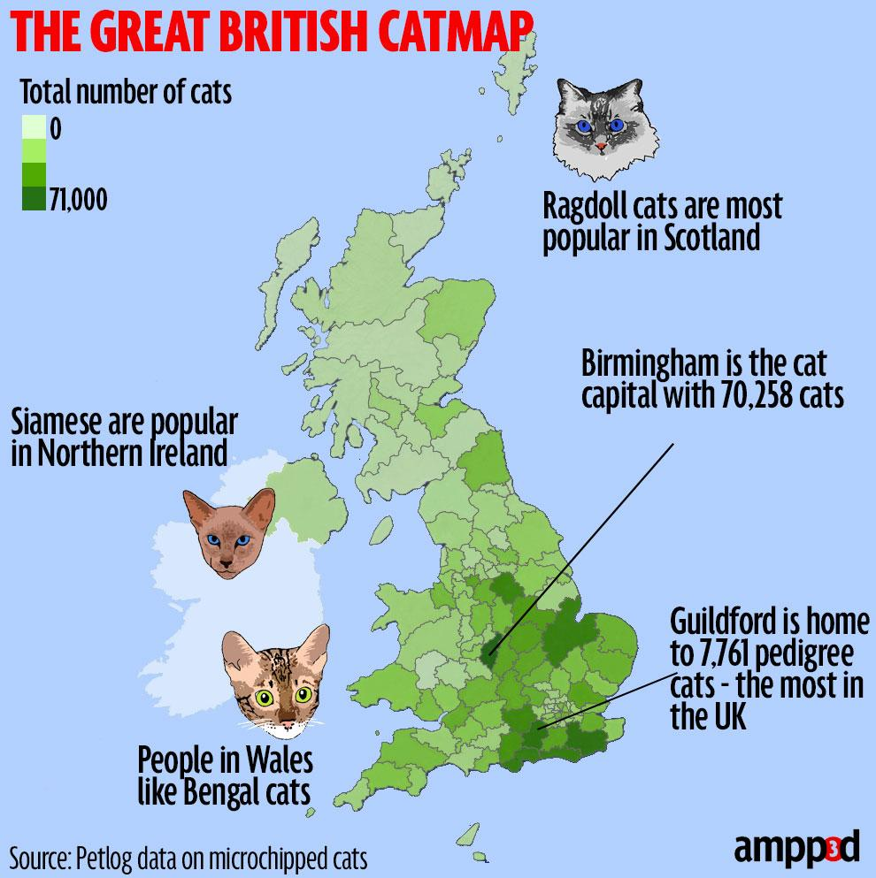
https://www.mirror.co.uk/news/ampp3d/cat-map-britain-wheres-most-5184092

Slide 6
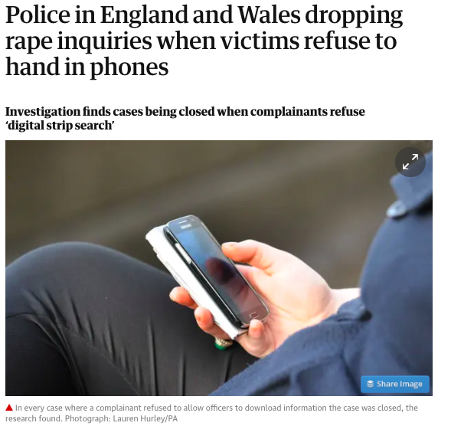
https://www.theguardian.com/society/2020/jun/17/police-in-england-and-wales-dropping-inquiries-when-victims-refuse-to-hand-in-phones

Slide 7

https://www.huffingtonpost.co.uk/entry/coronavirus-graphs-where-are-we-now-september_uk_5f4fa3e1c5b69eb5c0374139

Slide 8
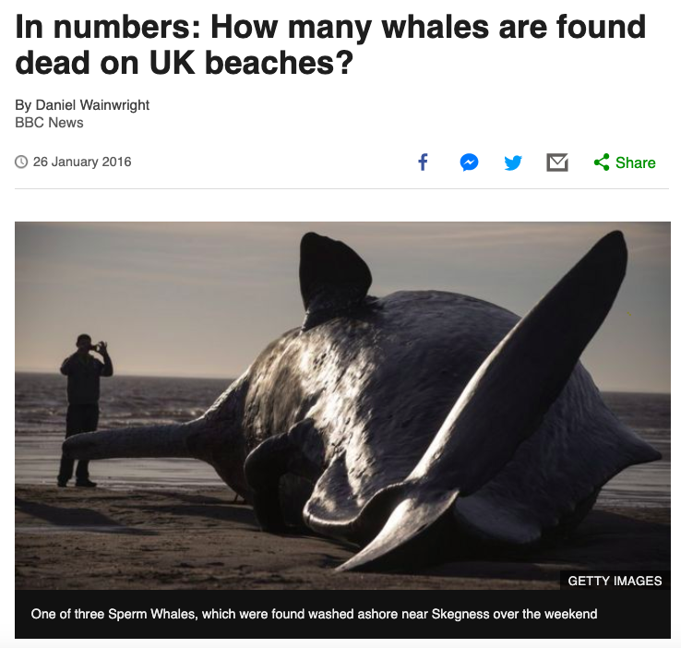
https://github.com/BBC-Data-Unit/dead-whales

Slide 9
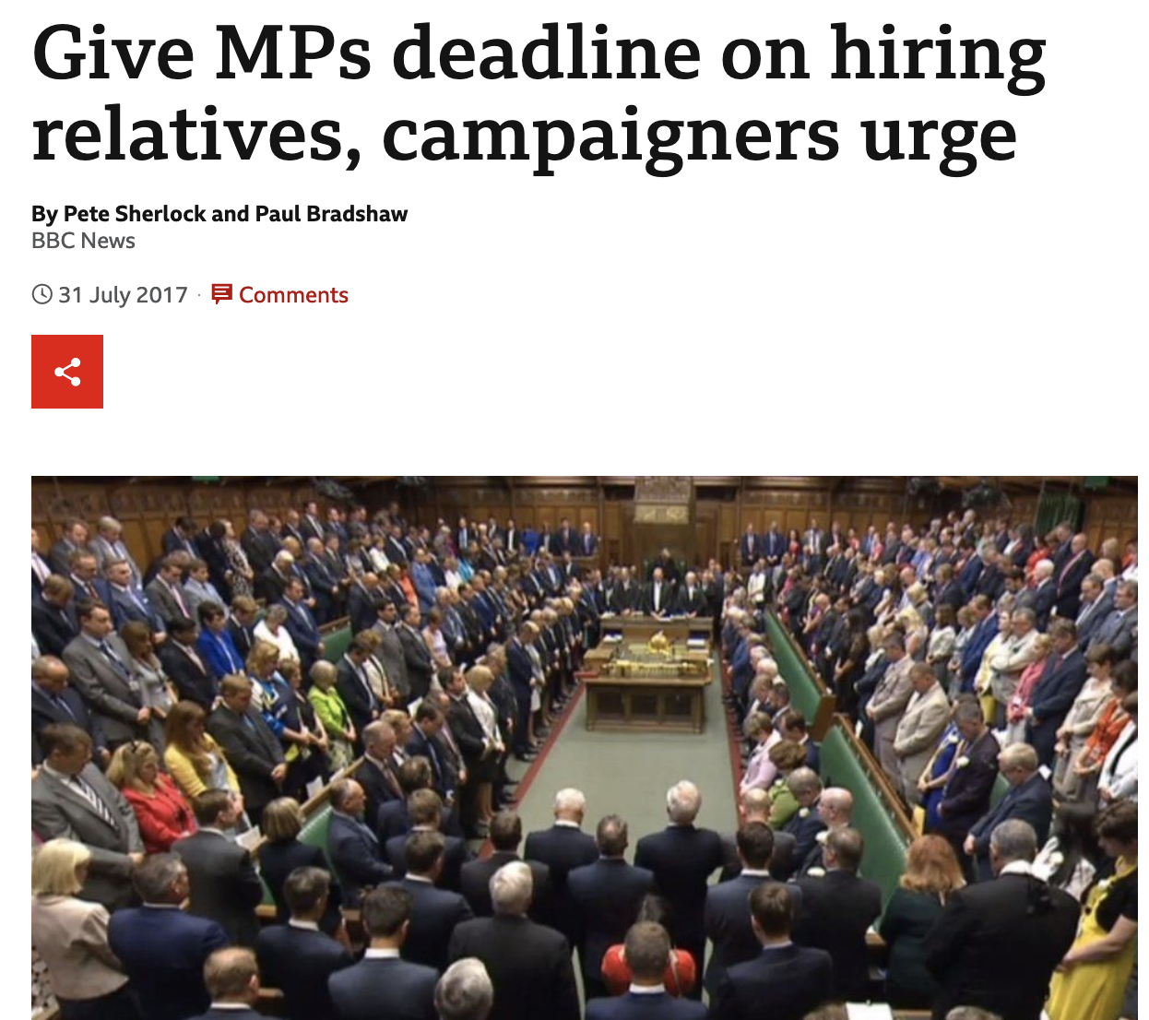
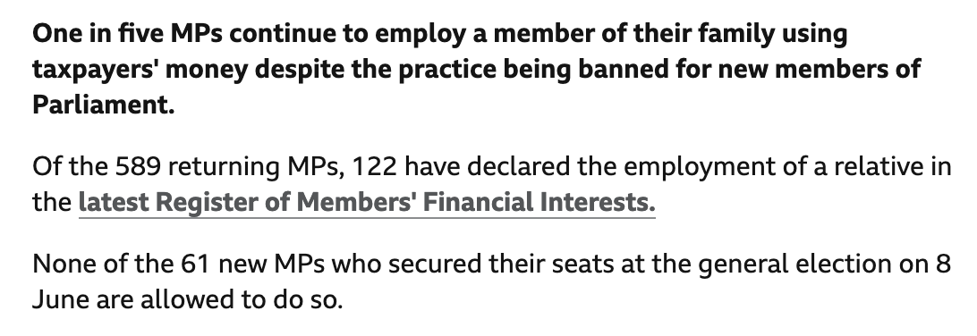
Source:
Idea
https://www.bbc.co.uk/news/uk-england-40709220

Slide 10
Do it now:
Pick 5 random stories from pinboard.in/u:paulbradshaw/t:dj
Scan through the story to try to identify how they got the data - was it reactive or proactive?

Slide 11
“Gans (1980) recognised that, with deadlines to meet, journalists’ overriding concern is to assess the efficiency of news sources. Thus, the journalists will assess the past suitability, productivity, reliability, trustworthiness, authoritativeness and articulateness of possible sources in making source choices, increasing the likelihood that “journalists are repeatedly brought into contact with a limited number of the same sources.” (Gans 1980)”
O'Neill, Deirdre and O’Connor, Catherine (2008) The Passive Journalist: How sources dominate the local news. Journalism Practice, 2 (3). pp. 487-500.

Slide 12
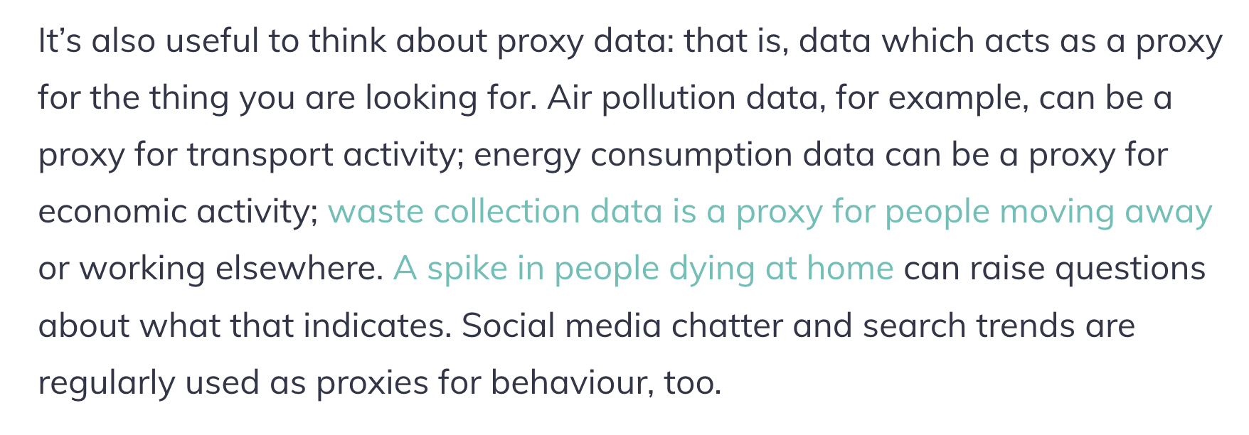
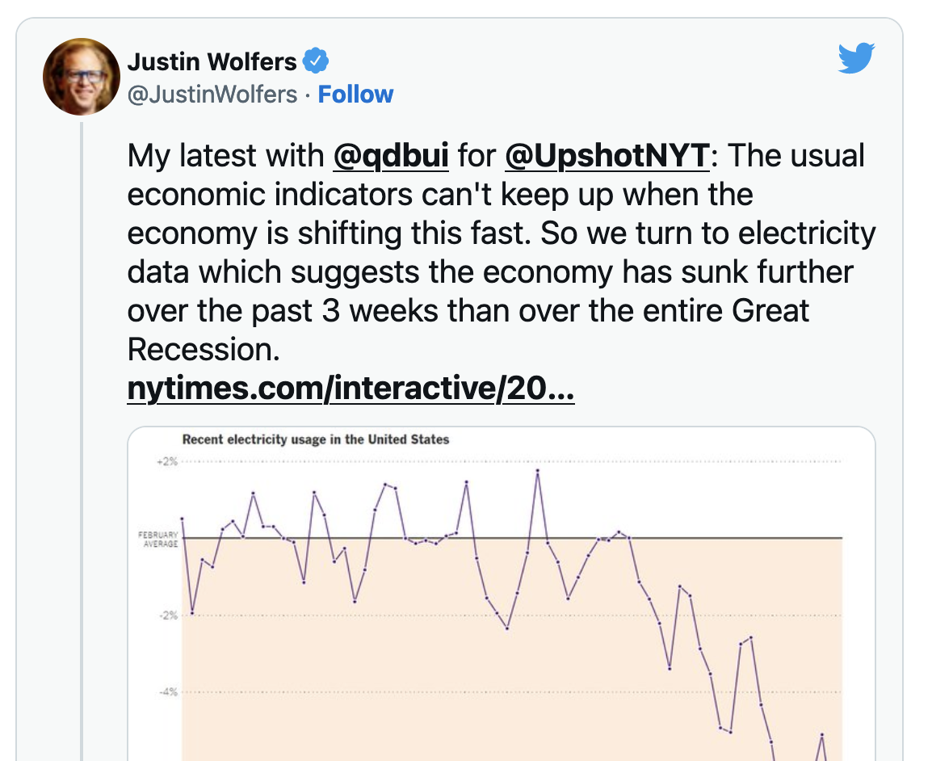
https://datajournalism.com/read/longreads/brainstorm-covid-19-data-story-ideas

Slide 13
“The most important piece of technology on my desk is my landline telephone. I think some people have the idea that “data journalism” means staring at spreadsheets until a story magically appears, but in the real world that almost never happens. The best stories almost always emerge from talking to people, whether they are experts or just ordinary people affected by the issues we write about. They’re the ones who pose the questions that data can help answer, or who help explain the trends that the data reveals, or who can provide the wrinkles and nuances that the data glosses over.”
Ben Casselman, New York Times

Slide 14
Takeaways:
Data journalism is lots of things - but few can do them all
You can play a lot of songs with just 3 chords
Sources and ideas can come from anywhere - not just a spreadsheet

Slide 15
Reading:
Data Journalism Heist

Slide 16




Watching:

